Slide 1
Bio Image Analysis
Christian Tischer
Advanced Light Microscopy Facility (Rainer Pepperkok)
EMBL Heidelberg
tischitischer@gmail.com

Slide 2
Menu
This Lecture:
Image analysis methods that I typically need to help people at our institute
Today’s Practical:
Using ImageJ
How to inspect my data and judge its quality
Conducting object-based measurements
Project (Sat&Sun):
Become an ImageJ expert
Apply most of the methods that I present today
Learn some programming to automate your analyses

Slide 3
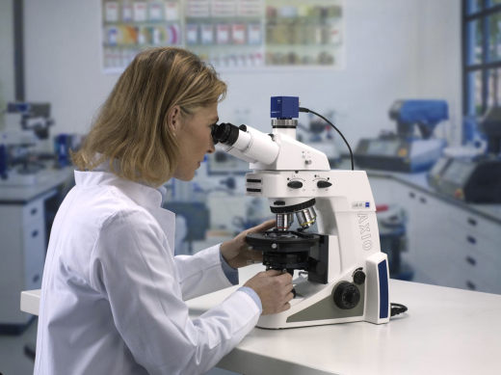
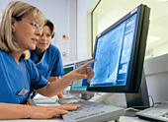
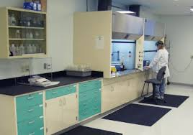
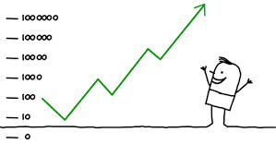

Bioimage Analysis
Microscopy
1. Acquire only few images of controls.
2. Establish your analysis workflow.
3. Acquire more data.
Image analysis
Sample preparation
QC & Statistics
Biological question

Slide 4
Image Analysis Software @ EMBL Heidelberg
Free, open-source
Fiji/ImageJ (2-D & 3-D)
CellProfiler (2-D batch analysis)
Ilastik (2-D & 3-D, supervised pixel classification)
CellCognition (2-D, supervised object classification)
Python
R
Commerical
Matlab
Imaris (3-D)
Arivis (huge 3-D)

Slide 5
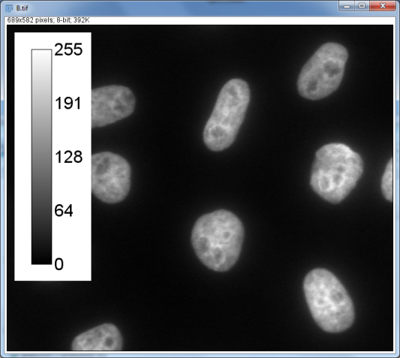
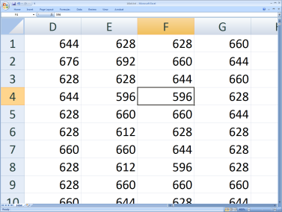
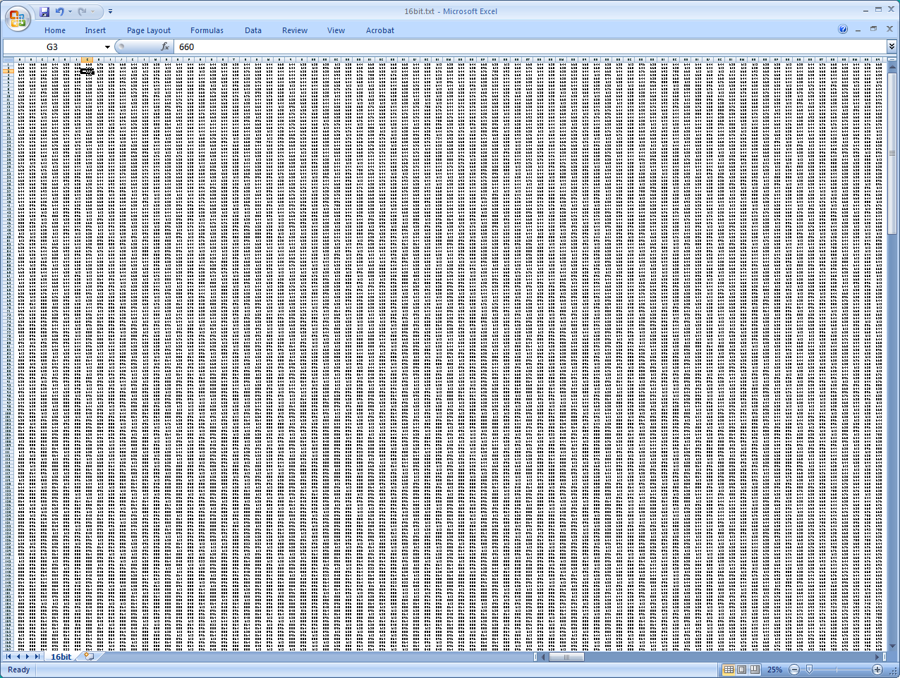
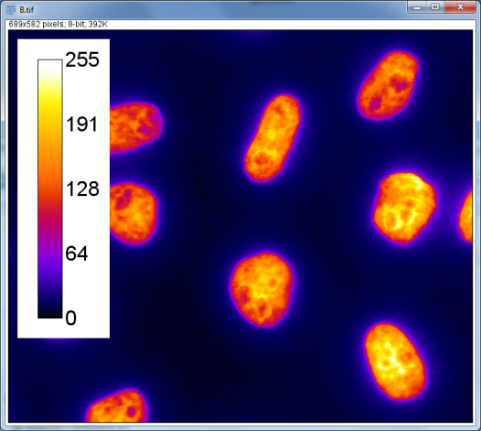
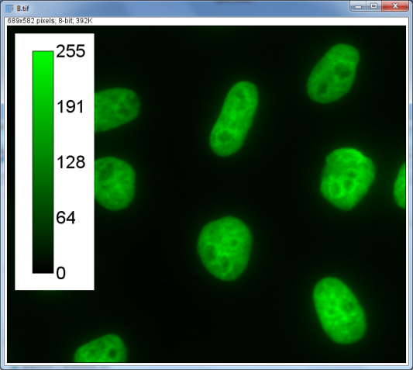
An image is a matrix of numbers
“Grays”
Lookup Table (LUT)
“Fire”
“Green”
8-bit: 0,1,..,255 (2^8-1) ☺
12-bit: 0,1,..,4095 (2^12-1) ☹
16-bit: 0,1,..,65535 (2^16-1) ☺

Slide 6
Object detection (segmentation)

Slide 7
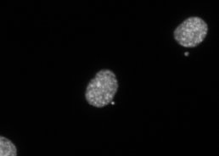
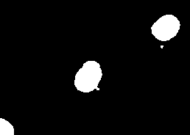
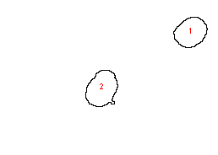
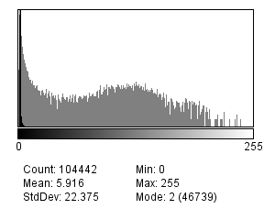
1. Intensity threshold (“binarize”) 2. Object detection (“connected components”) 3. Object filtering, based on location and shape
Gray value histogram
Finding the threshold:
Manual
Various automated methods
Threshold
Fiji: Image..Adjust..Threshold; Analyze..Analyze Particles
CellProfiler: IdentifyPrimaryObjects

Slide 8
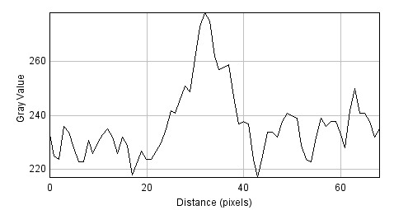
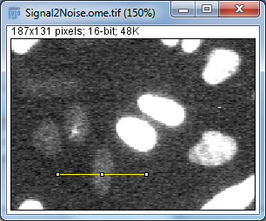
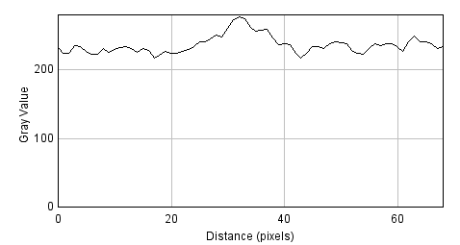
Signal to Noise (S/N)
BG Noise
Signal
Noise
Signal
Background
S/N = (Mean(Object)- Mean(BG)) / SD(BG)
Important for (automated) object detection
Important for intensity measurements
S/B = Mean(Object) / Mean(BG)
Important for ?

Slide 9

“Enhance” raw data
Raw data
Intensity threshold
Objects

Slide 10
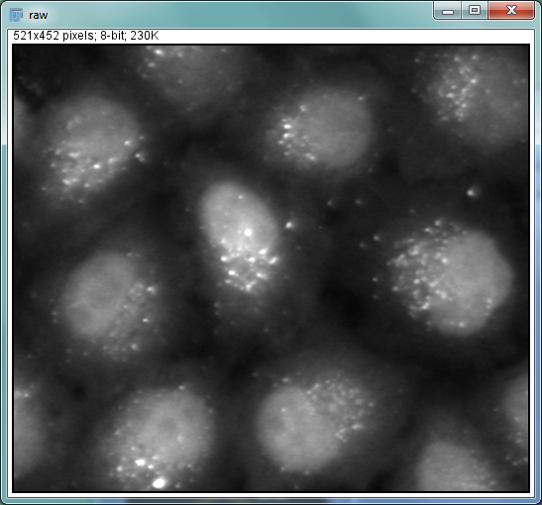
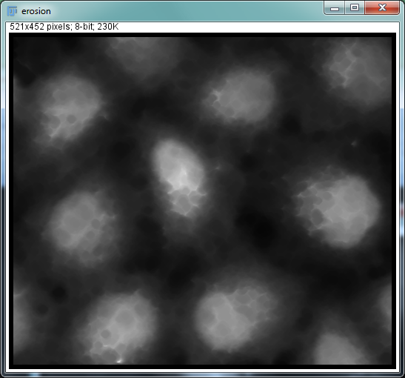
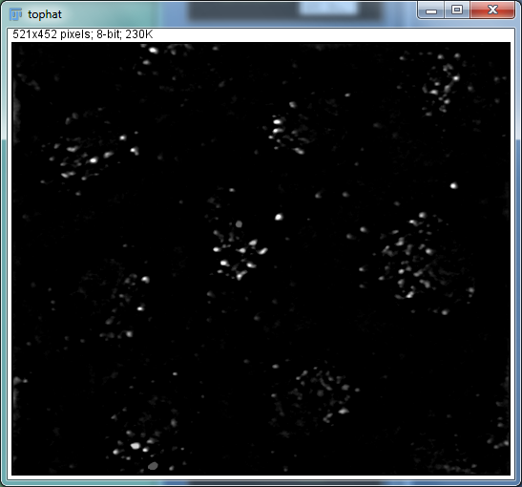
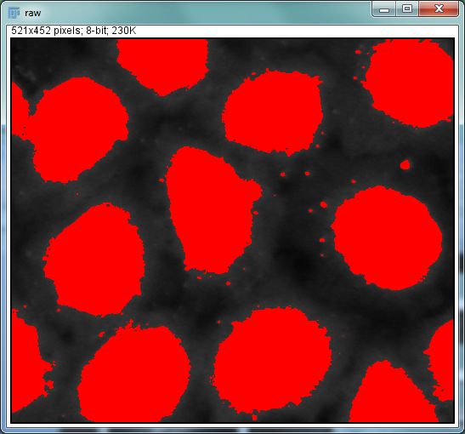
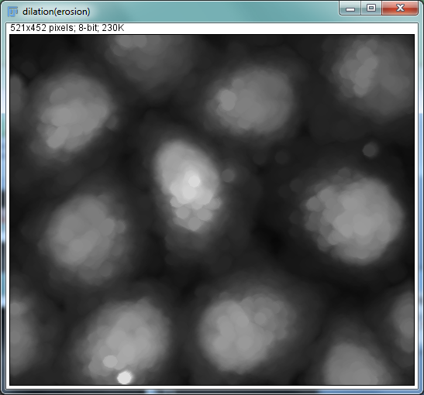
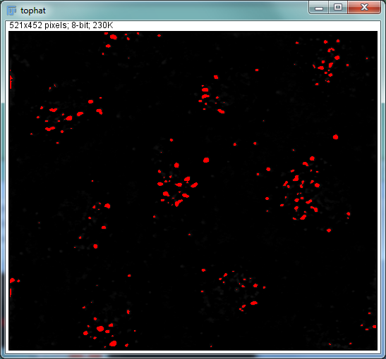
Morphological tophat filter removes local background
raw
erosion (r=7)
tophat = raw - dil(ero(raw))
raw & threshold
dilation (erosion, r=7)
top-hat & threshold

Slide 11
Tophat
Difference of Gaussian
Edge enhancements
Local texture
Many, many more……
“Enhance” raw data
Raw data
Intensity threshold
Objects

Slide 12
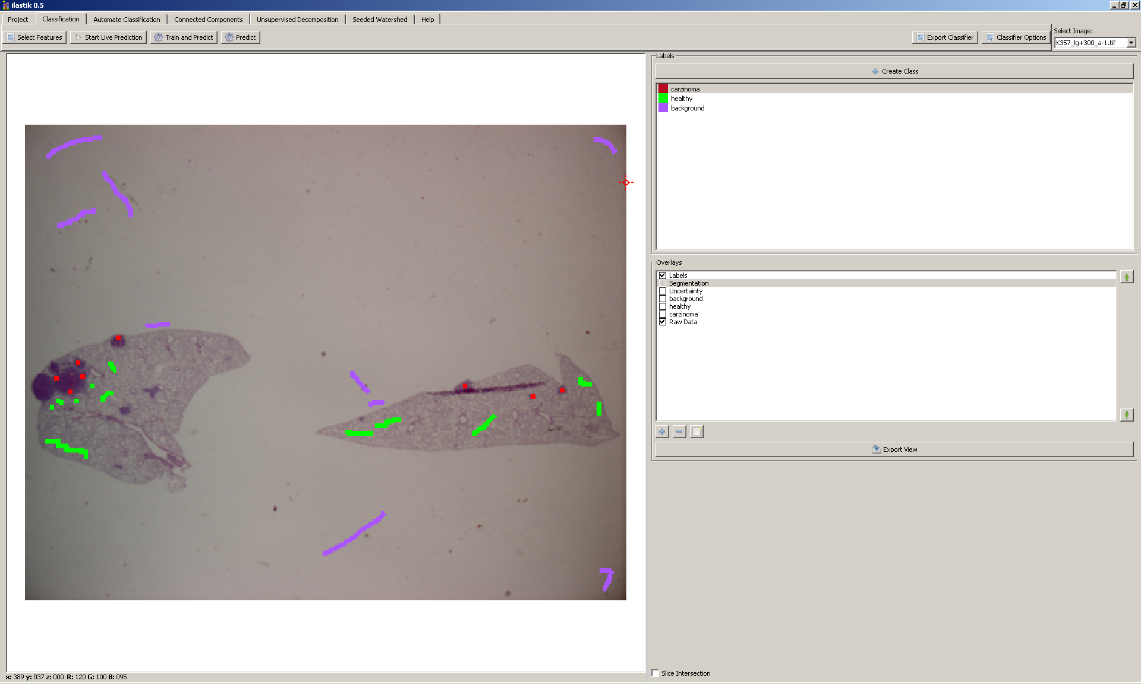
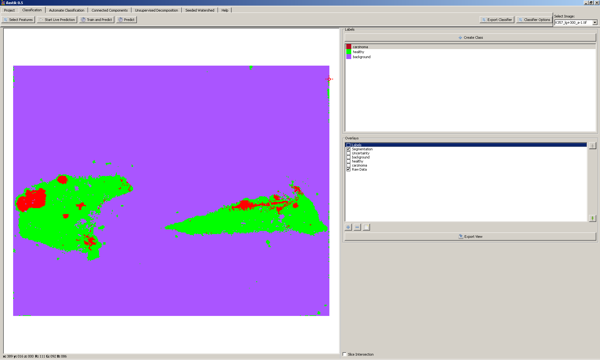
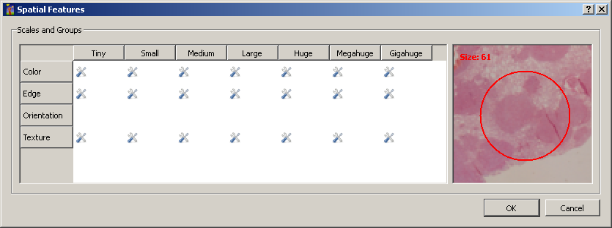
Supervised pixel classification
Label different image regions.
Software computes many different filters on the image.
Based on your labels it learns which filters distinguish the different regions best.
Lung sections with tumors, Hematoxylin & Eosin stain
Martina Mantovan, EMBL Monterodondo
Fiji/ImageJ:
Trainable Weka Segmentation
www.ilastik.org

Slide 13
Object (region) growing

Slide 14
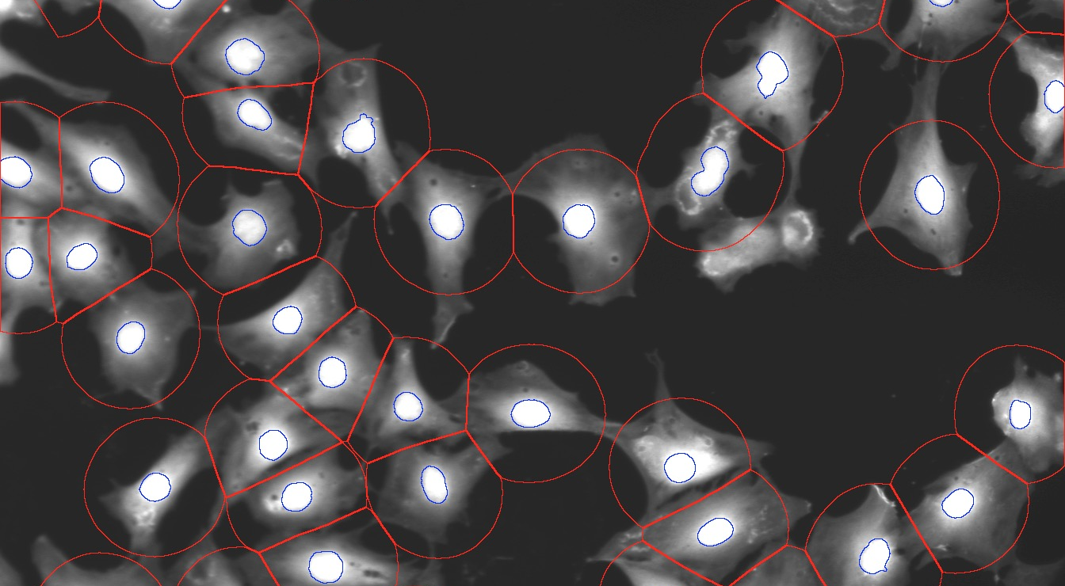
Distance-based region growing (“dilation”)
HeLa Kyoto cells, stained with HCS CellMask (Lifetechnologies)
Simple and robust, not very accurate

Slide 15
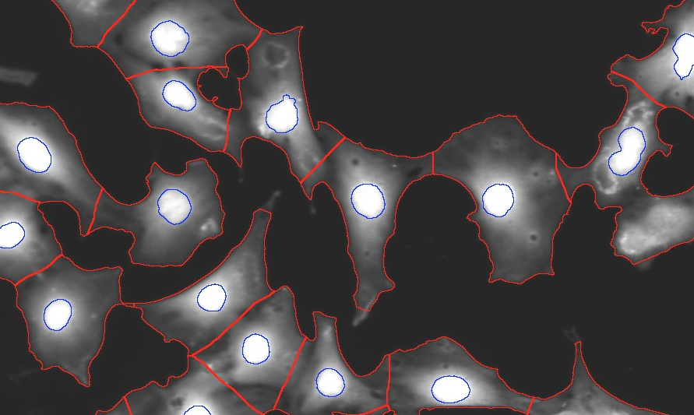
Object growing that stops when
(i) signal drops below threshold or (ii) runs into another region
You need a cytoplasm staining for this
You have to set a background threshold (to stop region growing)
Not accurate at cell-cell contacts

Slide 16
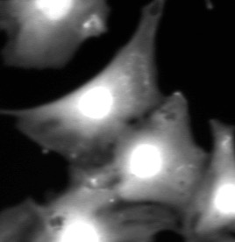
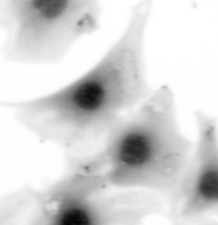
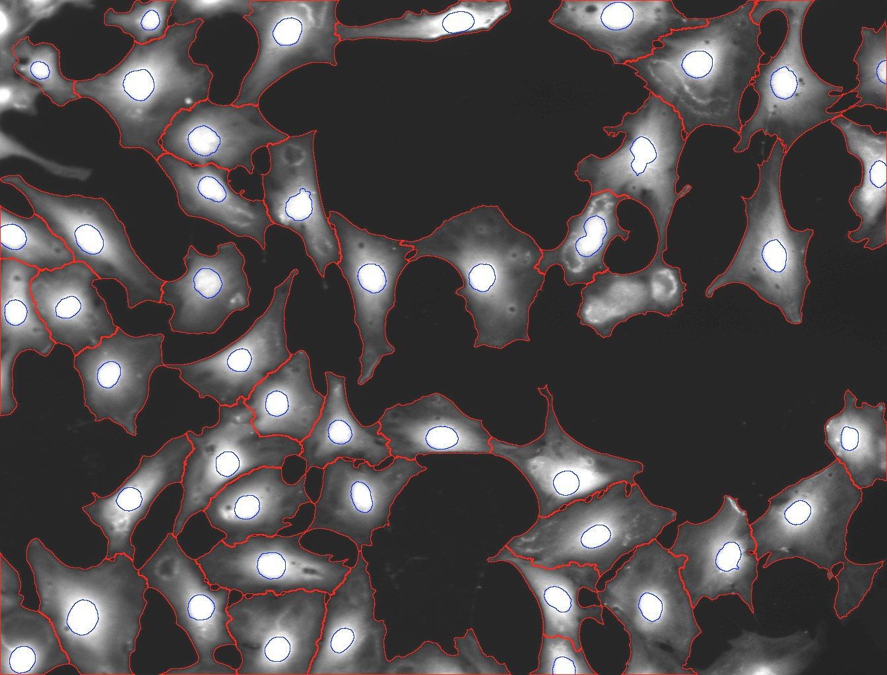
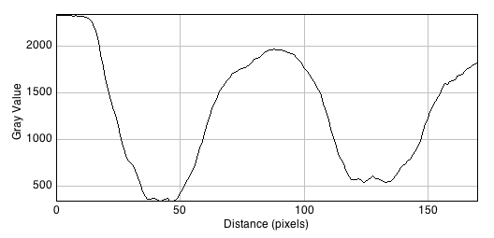
Image-based watershed to find cell-cell contacts
Raw data
Inverted
Nuc1
Nuc2
Nuc2
Fiji: Process..Find Maxima (Output type: segmented particles
CP: IndentifySecondaryObjects (Watershed - Image)
Nuc1

Slide 17
Recommendation for tissue culture cell detection: Nucleus stain & Whole cell stain Use nuclei as seeds for image-based watershed

Slide 18
Object splitting

Slide 19
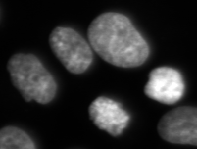
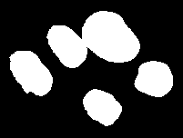
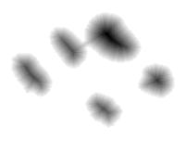

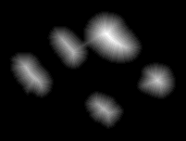
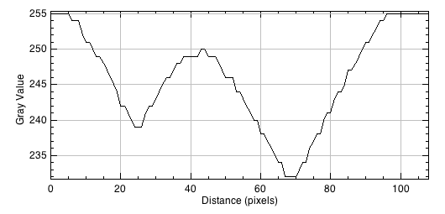
Shape-based object splitting by watershed filter on distance transform

Slide 20
Object Measurements

Slide 21
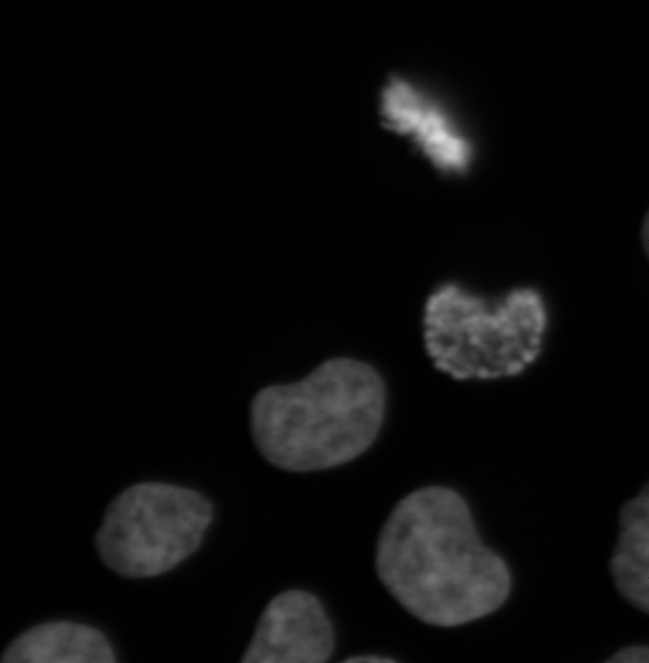
How would you measure the difference between these nuclei?

Slide 22
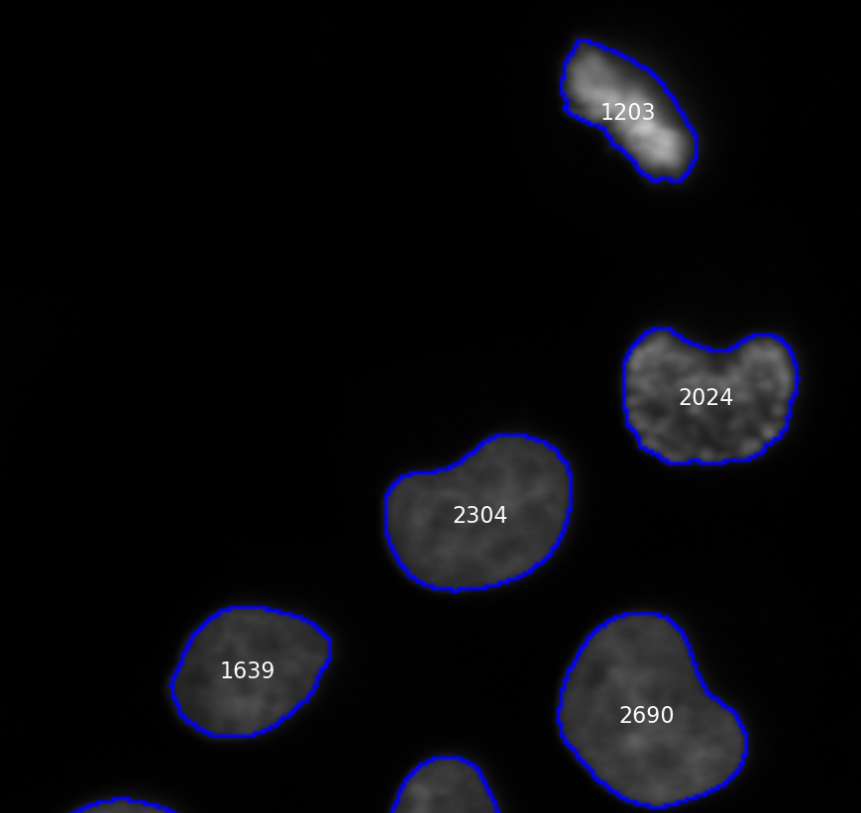
Area

Slide 23
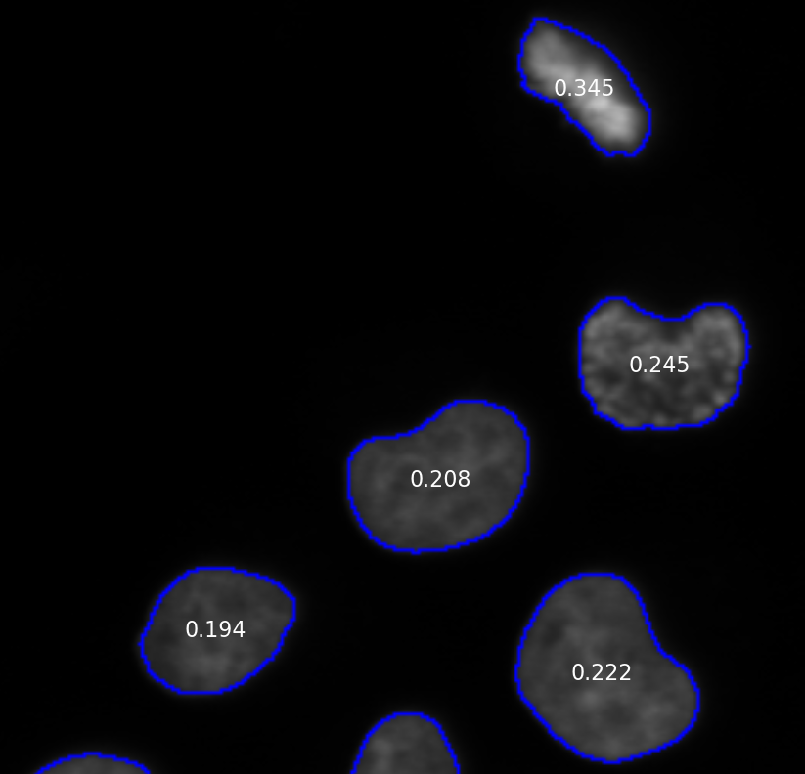
Mean intensity

Slide 24
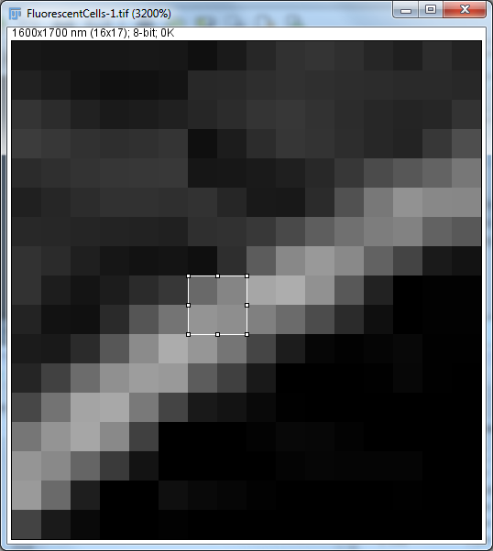
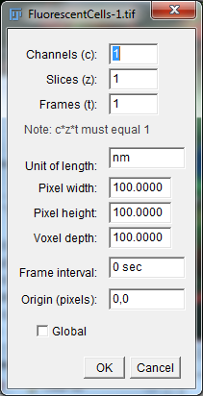
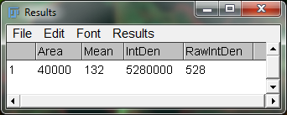
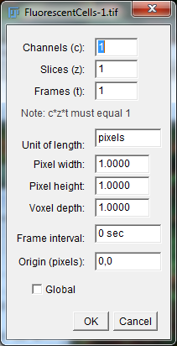
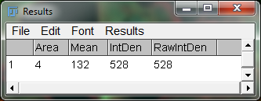
Mean vs. Sum Intensities
Gray values: 105, 133, 148, 142
Sum = 105 + 133 + 148 + 142 = 528
Area (in pixels) = 4
Mean = Sum / PixelArea = 132
Sum = Mean * PixelArea
ImageJ:
[Image > Properties]; [Analyze > Measure]
Sum ~ Total amount
Mean ~ Concentration

Slide 25
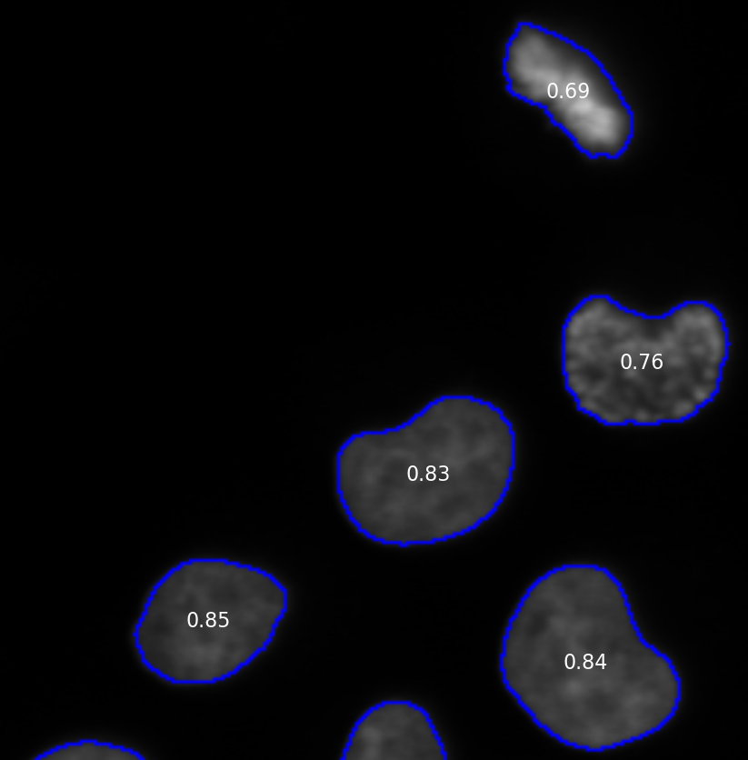
Form-factor = 4*π*Area / Perimeter^2
Circle: P = 2*π*R; A = π*R^2; FF = 4*π*π *R^2 / (2*π*R)^2 =
4*π^2*R^2 / (4*π^2*R^2) = 1
Line: FF = 4*π*L / L^2 = 4*π / L
(small for long lines)

Slide 26
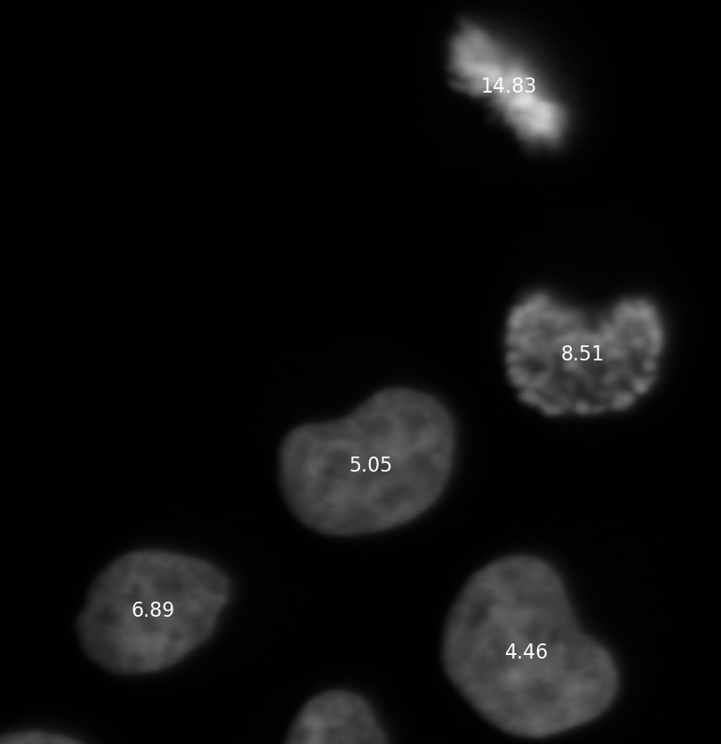
Haralick texture features
H1: Angular Second Moment
H2: Contrast
H3: Correlation
H4: Sum of Squares: Variation
H5: Inverse Difference Moment
H6: Sum Average
H7: Sum Variance
H8: Sum Entropy
H9: Entropy
H10: Difference Variance
H11: Difference Entropy
H12: Information Measure of Correlation 1
H13: Information Measure of Correlation 2
Haralick et al. (1973), "Textural Features for Image Classification," IEEE Transaction on Systems Man, Cybernetics, SMC-3(6):610-621.

Slide 27
Many features to distinguish phenotypes… which ones to choose?

Slide 28
Supervised object classification
“Feature vector” = (area, form factor, mean intensity, H1, …)
(200, 0.5, 0.4, 0.33, …)
?
(350, 0.75, 0.2, 0.55 …)
(400, 0.8, 0.3, 0.12, …)
Algorithms that predict unknown vectors based on known ones:
“Support Vector Machines”
“Random Forests”
(410, 0.85, 0.29, 0.54, …)
(440, 0.84, 0.3, 0.60, …)

Slide 29
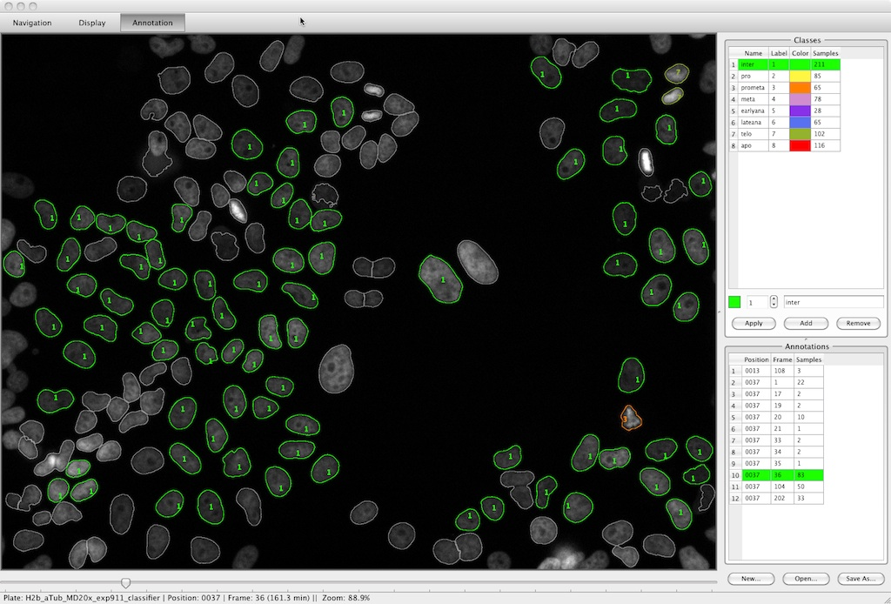
www.cellcognition.org

Slide 30
Intensity measurements

Slide 31
The meaning of intensities: widefield vs. confocal images

Slide 32
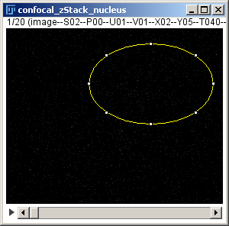
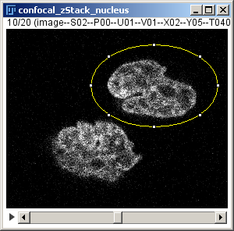
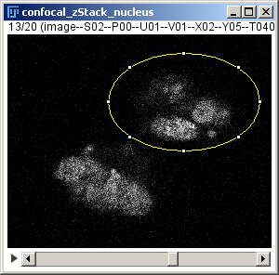

Confocal: optical sectioning (60x NA1.4 Airy1)
100
0

Slide 33



Widefield (20x NA0.7) selective focus but no optical sectioning

Slide 34
Widefield vs. confocal
Wide-field is good for measuring the total amount of a protein in thin samples (e.g., tissue culture cells).
Confocal microscopy is good for measuring local protein concentrations and for thick 3-D samples.

Slide 35
The Interpretation of Intensity Measurements
HeLa cell, Histone2B-mCherry
25 hours
1 hour
<
=
?=
<
Wide-field image; Sum intensity => Total expression level
Confocal slice; Mean intensity => Local concentration

Slide 36


Intensity measurements require background subtraction
Increase brightness & contrast!
Select a proper BG ROI
Measure mean intensity in the BG ROI
Subtract the measured value from all pixels in the image

Slide 37


Interpretation of intensities in confocal images
z-slice middle of cell
z-slice bottom of cell
z
y
y
x
x
You have to consider the shape of the
“Point Spread Function” (PSF)!
Thanks to Yin Cai for the data

Slide 38


Interpretation of intensities in confocal images
z

Slide 39


3-D projections
z-stack
Statistics, e.g.
Mean
Max
Sum
SD
…
z-max projection
Protein in dividing HeLa cell, data from Yin Cai @ EMBL, Heidelberg

Slide 40




Properties of sum and maximum projections
Sum projection
Sum projection
*
*
*
z
*
Max projection
*
*
Max projection
*
Sum projection:
good for whole cell quantification ~ total amount of protein (if you imaged the whole cell)
Max. projection:
good to find objects (and measure their intensity)
*
y
x

Slide 41
Automated Filtering (Quality Control, QC)

Slide 42



Automated Cell-based Quality Control (QC)
Mean intensity < 0.4
HeLa Kyoto cells
nucleus and autophagosomes
(Kenta Imai)
Typical cell QCs:
Abnormal (nucleus) morphology
Contains too many saturated pixels
Expression level too low or too high
CellProfiler: FilterObjects
Fiji: Analyze.Analyze Particles

Slide 43


Automated Image QC
Measurement: Focus quality (“PowerLogLogSlope”) from CellProfiler module MeasureImageQuality
-2.0
-3.1
Typical image QCs:
Focus quality
Background intensity
Number of cells ⬄ cell density

Slide 44


Automated image analysis
Image analysis
Many images
Many numbers
Correct?
Significant?

Slide 45




Categorical Plots
+
+
[1] "Control mean = 7.24 sd = 4.55"
[1] "BFA t-test vs. Control = 2.73e-06 (**)"
[1] "Nocodazole t-test vs. Control = 3.72e-20 (**)"

Slide 46




Heatmaps
Blue = little actin ruffling
Red = much actin ruffling

Slide 47
You need a convenient* way to link back the numbers to the images!
*(otherwise you might not do it)

Slide 48

Thank you for your attention!
Thanks for discussions or slides:
Antonio Politi (EMBL HD)
Kota Miura (EMBL HD)
Malte Wachsmuth (EMBL HD)
Thanks for sharing data:
Yin Cai (EMBL HD)
Anita Ripplinger (University of Copenhagen)

Slide 49
Data organisation

Slide 50

Structure your data and give it computer-readable names
“Assay1 Rep 2014,03,20 Control 1.tif”
“Assay1 Replicate 2014,03,20 Control 10.tif”
BiologicalAssay--ExperimentalBatch--Treatment--ID
“HeLa_Endocytosis--2014-03-20--NegCtrl--001.tif”
“HeLa_Endocytosis--2014-03-20--NegCtrl--002.tif”
“HeLa_Endocytosis--2014-03-20--PosCtrl--001.tif”
“HeLa_Endocytosis--2014-03-20--TreatA--001.tif”
“HeLa_Endocytosis--2014-04-01--NegCtrl--001.tif”
“HeLa_Endocytosis--2014-04-01--TreatA--001.tif”

Slide 51


QC on automated background measurement
*
*
*
Typical image QCs:
Focus quality
Background intensity
Cell density

Slide 52
Background subtraction

Slide 53
Selecting the right background ROI
Increase brightness & contrast!

Slide 54


Background subtraction issue: dense cells
If there is no clear background region you have a problem…
Solutions:
Seed your cells less dense
Select image fields with clear background
Measure the background in another (neighboring) image

Slide 55




Statistics ⬄ Automated analysis…
www.cellprofiler.org
Find damage sites (auto threshold the protein Ctrl image)
Use damage sites as “seeds” and “dilate” to find rest of cell (automated “region growing”)
Measure sum signal in cell ROIs in background corrected image (background subtraction on whole image)
Measure sum signal in damage ROIs in top-hat filtered image
Compute the ratios…
“Signal in damage region”
= Sum(Cut)–Mean(CutNH)*Area(Cut)
= Sum(Cut) if Mean(CutNH)=0

Slide 56




Local background subtraction by top-hat filtering
raw
min(raw, r=15)
max(min(raw), r=15)
tophat =
raw-max(min(raw,r=15)

Slide 57
Background subtraction

Slide 58




Manual background measurement
Carefully select background ROI (increase brightness to see “dirt” and dim cells)
Measure median intensity
The resulting image should support negative numbers
Fiji: Image..Type..32-bit; Process..Math..Subtract

Slide 59
Automated background measurement: Measure intensity outside objects
*
*
*
Each image has its own background measured
Fails if cells are too dense…

Slide 60



Background subtraction for small isolated structures: Top-hat filtering

Slide 61

Quantitative intensity measurements are not possible with saturation
Signs of saturation:
Areas with exactly same high intensity (line-profile)
Intensity values at the end of bit depths: 255 (8 bit); 4095 (12 bit); 16383 (14 bit); 65535 (16 bit)
Check at microscope and adapt excitation and signal amplification such that no sample is overexposed (can be tricky if you have many samples…)

Slide 62
Quantitative intensity measurements
Only meaningful in comparison => you need controls (measured with same settings in same microscopy session)
Saturated pixels cannot be quantified
You need to properly subtract the image background
NEVER save your images in a different format or convert the bit-depth, unless you KNOW EXACTLY what you are doing
Be aware about the different biological interpretations of mean vs. sum intensities in confocal vs. widefield imaging

Slide 63
Thank you for your attention!

Slide 64
What to measure, exactly?

Slide 65

“Actin ruffling” in siRNA knockdown conditions
Let’s say you managed to detect the ruffle pixels;
What would you measure?
number of ruffle pixels per image
number of ruffle pixels per cell
ruffles pixels per cell / cell area
integrated intensity in ruffle area
integrated intensity in ruffle area / integrated intensity in whole cell
mean intensity in ruffle area
…
Mouse Embryonic Fibroblasts
stimulated with PDGF 20 ng/ml for 10 min
Salvatore Corallino, IFOM, Milan

Slide 68


Difference of Gaussian Filter

Slide 69




Small Gaussian blur
Large Gaussian blur
Difference of Gaussian
Difference of Gaussian & Threshold

Slide 70
Difference of Gaussian vs. Top-hat …
Difference of Gaussian filtering:
Inherently smoothens the image
Enhances spots but also edges
Top-hat filtering:
Sensitive to noise
Does not enhance edges
Filter X:
…..
Filter Y:
….

Slide 71
Statistical Analysis..…

Slide 72
How many images do I need?
Mean
Property of your assay and the biology
More experiments => your estimation of the mean is more precise
Standard deviation (SD)
Property of your assay and the biology
More experiments => your estimation of the standard deviation is more precise (put the error formula)
Standard error of the mean (SEM)
SD/(Sqrt(NumberOfExperiments)-1)
More experiments => the SEM decreases <=> you know more precisely what the mean is

Slide 73
Stuff

Slide 74

distance transform

Slide 75

distance-transform region growing (watershed)

Slide 76
Local intensity thresholding
ImageJ:
Image..Adjust..Auto Local Threshold
CellProfiler:
Niblack
Implements Niblack's thresholding method:
pixel = ( pixel > mean + k * standard_deviation - c) ? object : background
Parameter 1: is the k value. The default value is 0.2 for bright objects and -0.2 for dark objects. Any other number than 0 will change the default value.
Parameter 2: is the C value. This is an offset with a default value of 0. Any other number than 0 will change its value. This parameter was added in version 1.3 and is not part of the original implementation of the algorithm. The original algorithm is applied when C = 0.
Niblack, W (1986), An introduction to Digital Image Processing, Prentice-Hall
Ported from ME Celebi's fourier_0.8 routines [3] and [4].
issues: inhomogeneous background (such as cellular cytoplasm)
try with cellprofiler (latest version on my mac)

Slide 77






Enhancement of locally bright structures by top-hat filtering
…

Slide 78
Enhancement of locally bright structures by top-hat filtering
…

Slide 79

gradient-based region growing (watershed)

Slide 80

Standard deviation of intensity

Slide 81
widefield microscopy is the best method to measure total protein levels in tissue culture cells

Slide 82




Slide 83

Scatter

Slide 84

> "Performing Image QC:"
> "Measurement: ImageQuality_PowerLogLogSlope_DNA
> " Allowed range: -2.4 .. 100 and not NA.“
> " Images total: 69072"
> " Images failed: 485”

Slide 85

Staining not sufficient or missing to segment all objects of interest (e.g. cellular cytoplasm)
Sub-optimal object segmentation
Sample preparation
Microscopy
Image Analysis
Statistics
Sub-optimal type of microscopy
Sub-optimal filter settings
Saturated signals
Images saved in wrong format
Transfection efficiency too low
Staining did not work
Cell density too high or low
Cells mounting
No significant difference between positive and negative controls
Staining “gradients”
Cell density “gradients”
Notes:
The actual image analysis part is small and often not the actual challenge.
ASK for more ideas (Faba…)

Slide 86

Image-based watershed using nuclei as “seeds”
You need a cytoplasm staining
You have to set the background threshold
Accurate at cell boundaries and cell-cell contacts

Slide 87

Watershed on image gradient (maybe try for membrane staining…)

Slide 88
Detailed Outline
Image analysis software
Data organisation
Object detection
Intensity threshold
Image filtering to enhance objects of interest
Top-hat filter
Difference of Gaussian filter
Supervised pixel classification
Object splitting
Object dilation (region growing)
Distance based
Watershed
Object measurements
Intensity
Shape
Texture
Classification
Quantitative intensity measurements
Interpretation depending on microscopy method
Background subtraction
Automated quality control (filtering)
Object-based
Image-based

Slide 89
Typical image QCs:
Focus quality > ?
Background intensity < ?
? < Cell density < ?

